Slide 1
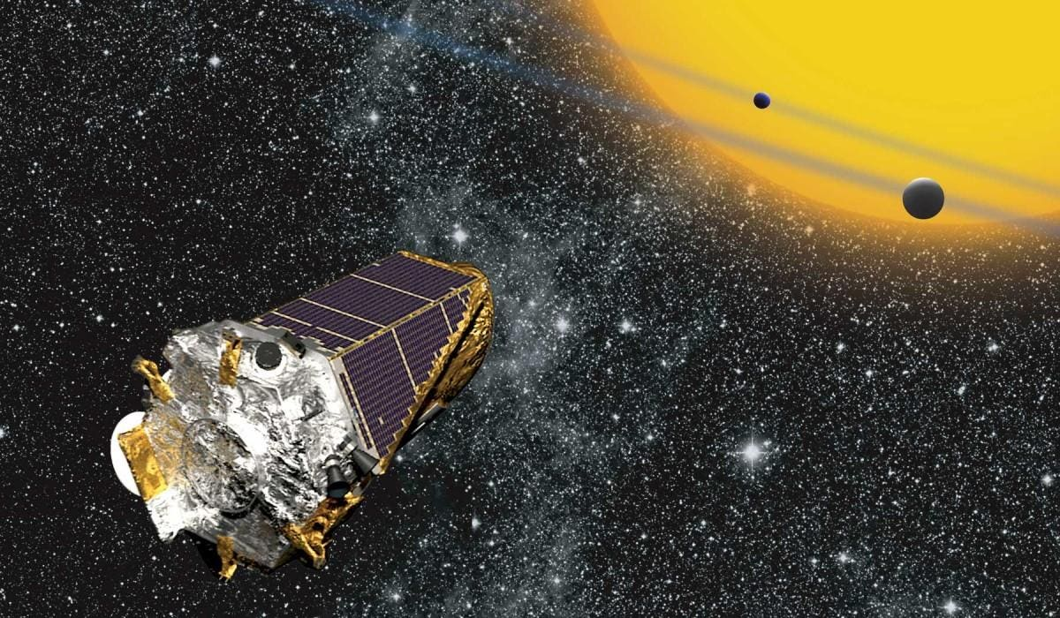
Binary Classification of Kepler Objects of Interest with Supervised Machine & Deep Learning Methods
Lelia Deville
Systems Engineering – Mechanical Concentration, PhD Student

Slide 2
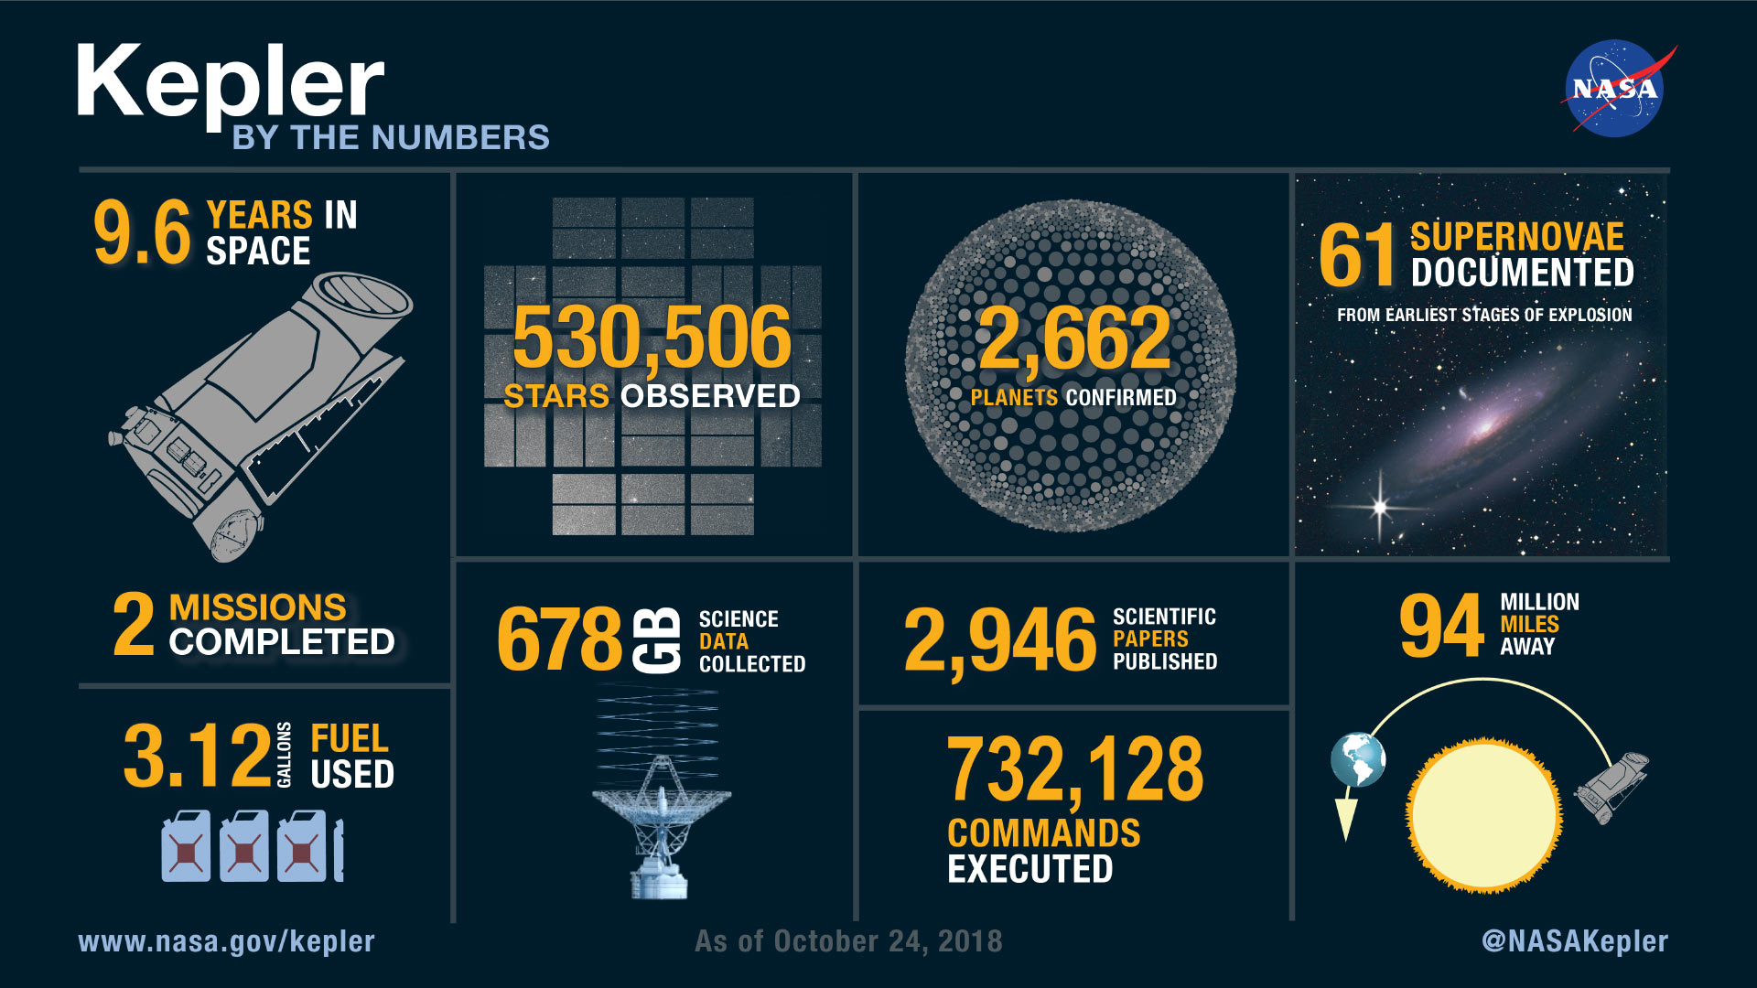
Notes:
Kepler space telescope was the first planet-hunting telescope
Uncovered the potential for the existence of billions of exoplanets
Obtained thousands of observations on Kepler Objects of Interest (KOI)

Slide 3
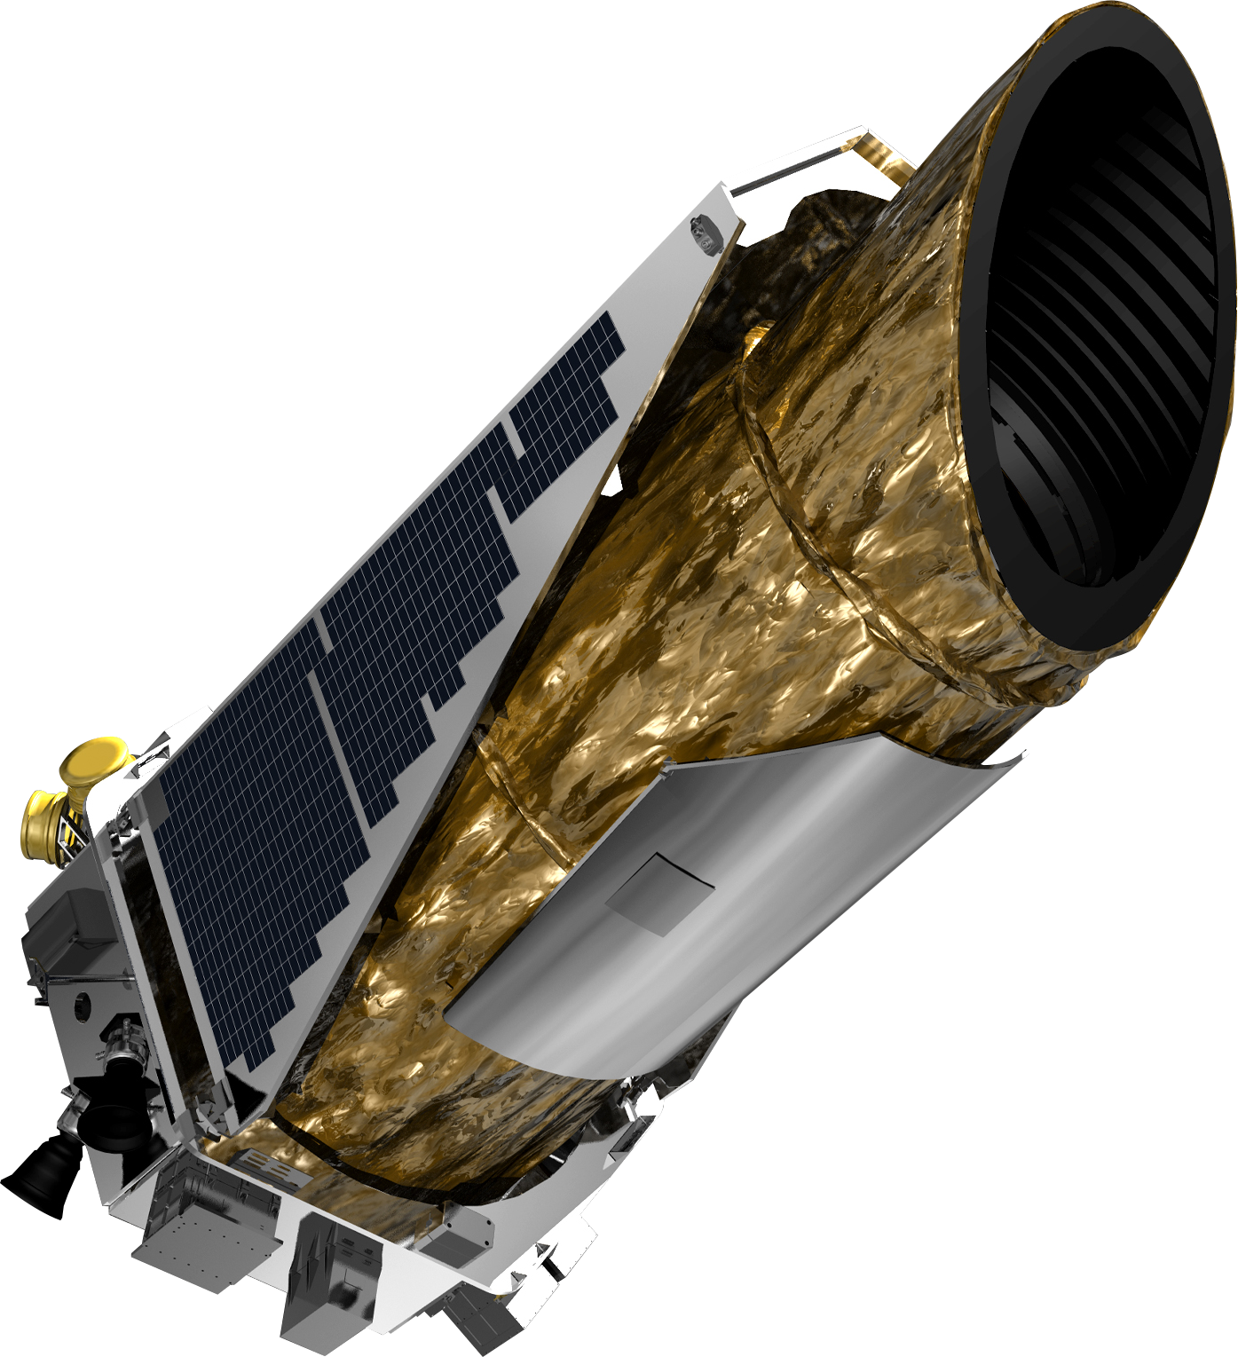
About the dataset
NASA Exoplanet archive
Specifically used KOI table – with 9564 total entries
Objects are classified as confirmed, candidate, and false positive
False positive objects remain to provide valuable info
Contains info on planets & star: orbital period, eccentricity, inclination, radius, stellar age, stellar mass, + much more
Notes:
Exoplanet archive contains data on thousands of confirmed exoplanets and other objects of interest not just from the kepler mission but from any valid observation of a candidate exoplanet
There is a table just for objects of interest found by the kepler & K2 missions – these include classes like candidate, confirmed, and false positive
Objects later found to not be an exoplanet remain in the data base as a ‘False Positive’ since the data can be valuable for determining if future objects are exoplanets or not

Slide 4
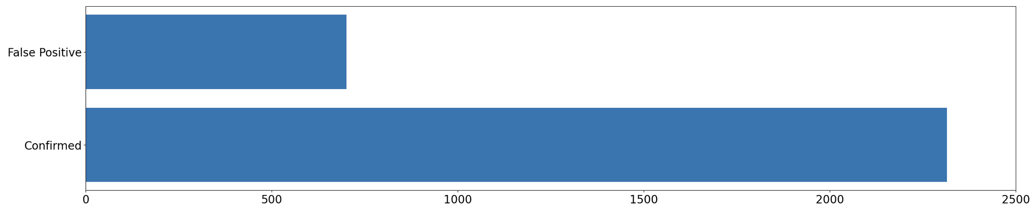
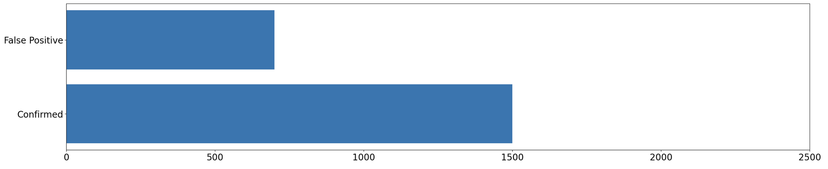
Dataset Contents
*Also contained candidates – to be addressed later
Notes:
Had to reduce the ratio because the models were extremely bias towards confirmed. Wanted to keep a higher majority so reduced 3.3:1 down to 2:1

Slide 5
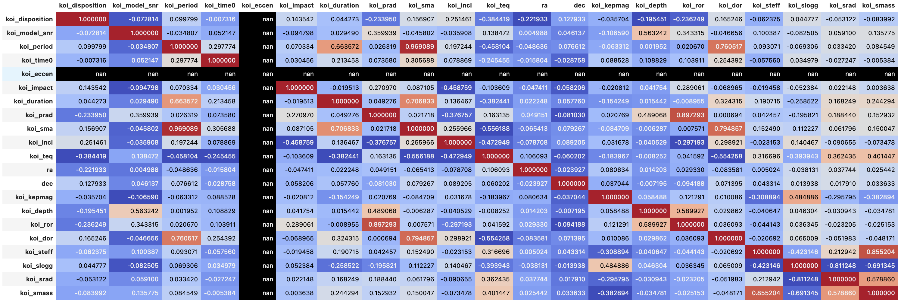
Collinearity Check
Notes:
Collinearity is when two variables are linearly correlated so it messes with the weights of those variables in the model

Slide 6
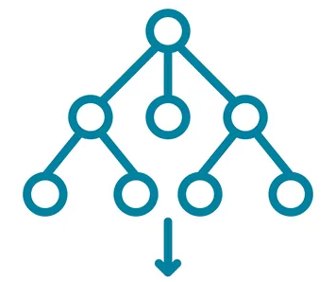
About the model
This problem requires a classification model
Data comes with the labels (confirmed, false positive etc.) so this is called supervised learning
Many options (some were tested – SVC, MLPClassifier), but Random Forest chosen
Two datasets tested:
Planetary + Stellar Data
Planetary Data
Notes:
Because we’re sorting the objects of interest into groups, this is classification
And since the data we’re using the train the model comes with the labels, it is supervised. There are lots of options for machine learning models, and a couple different ones were tested like SVC & MLP
The best performing one was random forest
At first I did all the data – but then wanted to remove the collinearity and realized it was happening with a lot of the star parameters, so I decided to try two datasets

Slide 7
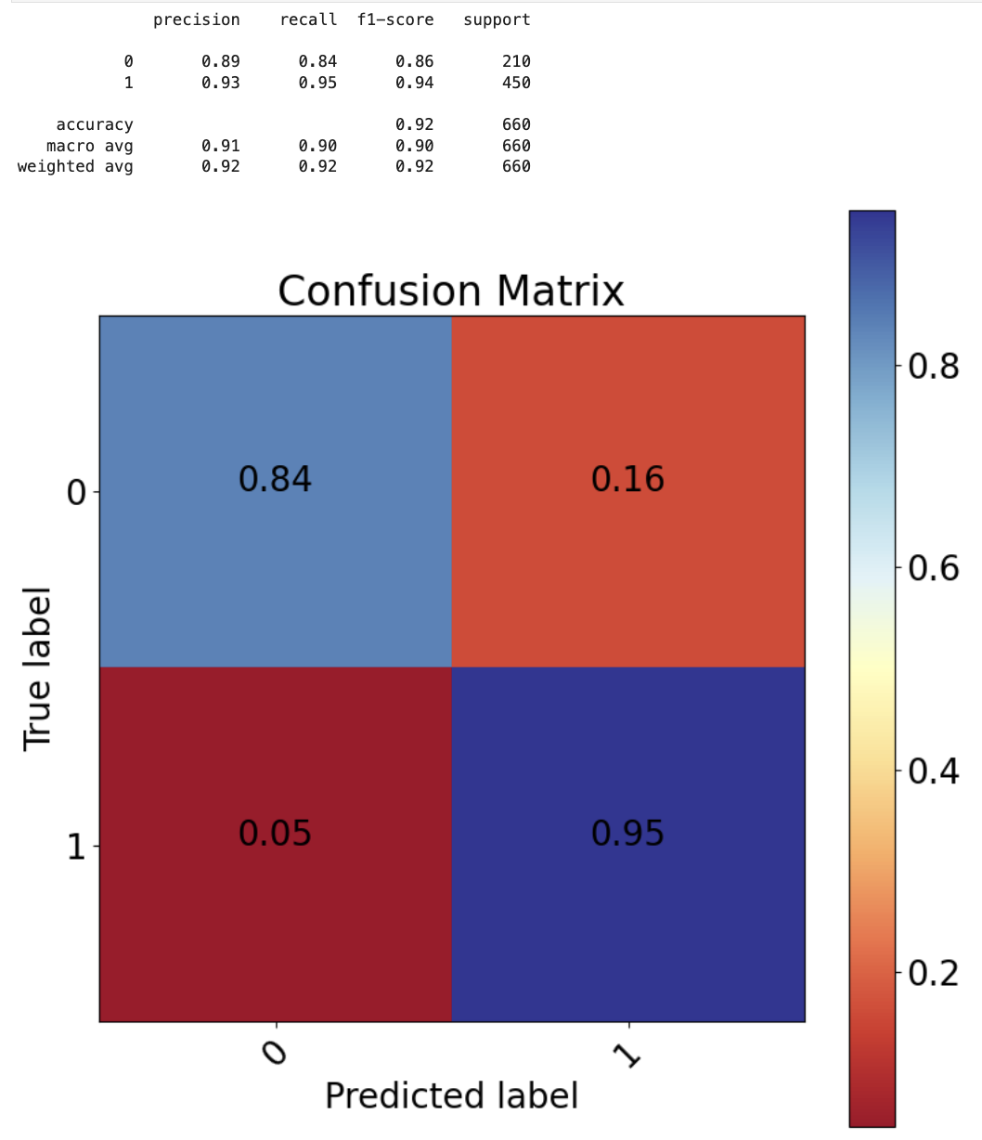
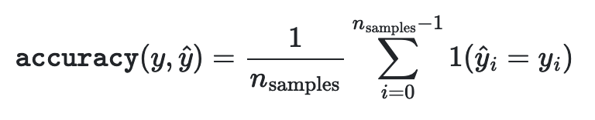
Planetary + Stellar
Overall Accuracy score of 92%
There were 2x as many 1 (Confirmed), so it makes sense the model is better at classifying these
Notes:
Confusion matrix shows what proportion of data was labeled correctly and how it was mislabeled
Results of the model using planetary and stellar data – overall accuracy of 92%
Slight bias towards confirmed which makes sense given the distribution

Slide 8
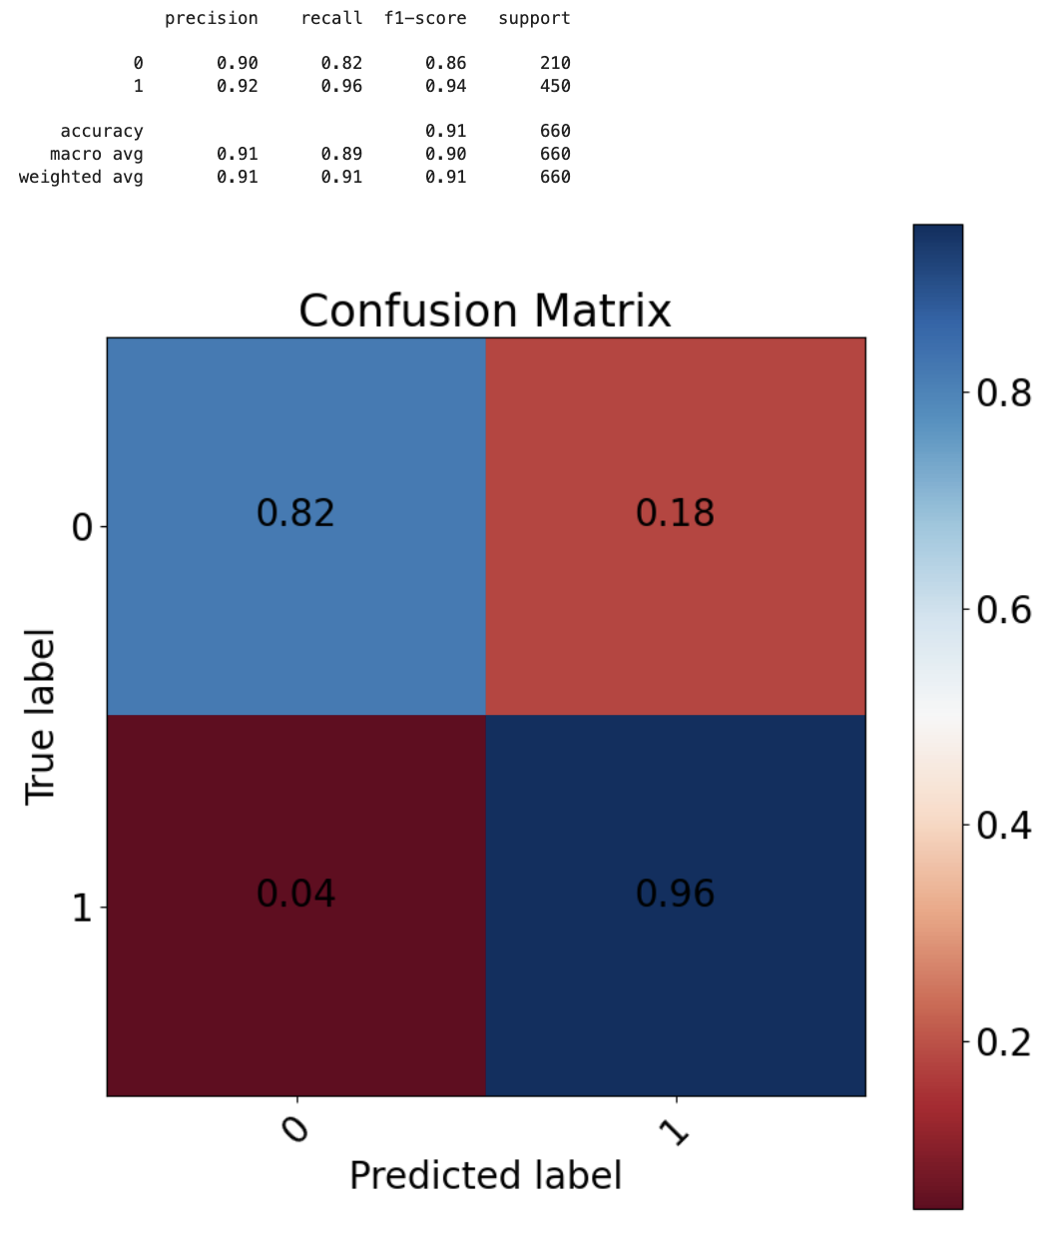
Planetary
Overall Accuracy score of 91%
Still slightly imbalanced, but not much different
Removed all stellar parameters (mass, radius, etc.) but saw no major change in model performance
Notes:
Using just the planetary data did not cause any significant reduction in accuracy

Slide 9
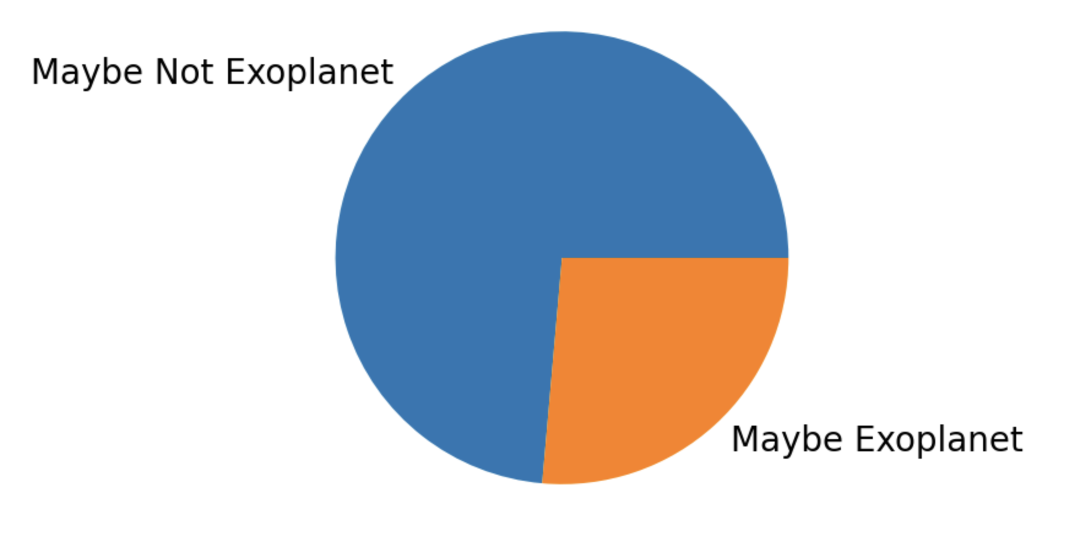
Candidate Dataset
Recall the portion of planets classified as candidate
Based on initial proportion (3.3:1 confirmed/false positive), this seems unlikely? Unless?
The trained model was up to 96% accurate in classifying the confirmed objects - & 85% in classifying the false positives, so this could be plausible
Maybe conservative labeling is better?
Notes:
We can use the model to make predictions on those objects that were labeled as candidates. We have no way to confirm this since these are still candidates but maybe this can tell us which ones are worth pursuing further first? Based on the initial proportion this seems wrong but given the high model accuracy this could be plausible. Also maybe conservative labeling is better? We don’t want to confirm planets without being 110% certain that they are. Better to remain skeptical for longer?

Slide 10

Deep learning: About the model
Wanted to try a simple Deep Learning Model
Machine Learning vs Deep Learning
Neural Network with only 2 hidden layers
‘Black Box’ Model
Notes:
Machine learning uses information given to it by humans to learn on its own and create a model, while deep learning is able to use internal methods to take given input and learn things about it without needing a human’s intervention. Most common simple type is a NN, which uses layers of neurons to mimic brain behavior. These are really kind of black box, since we don’t know exactly what transformations the model is doing at each step

Slide 11
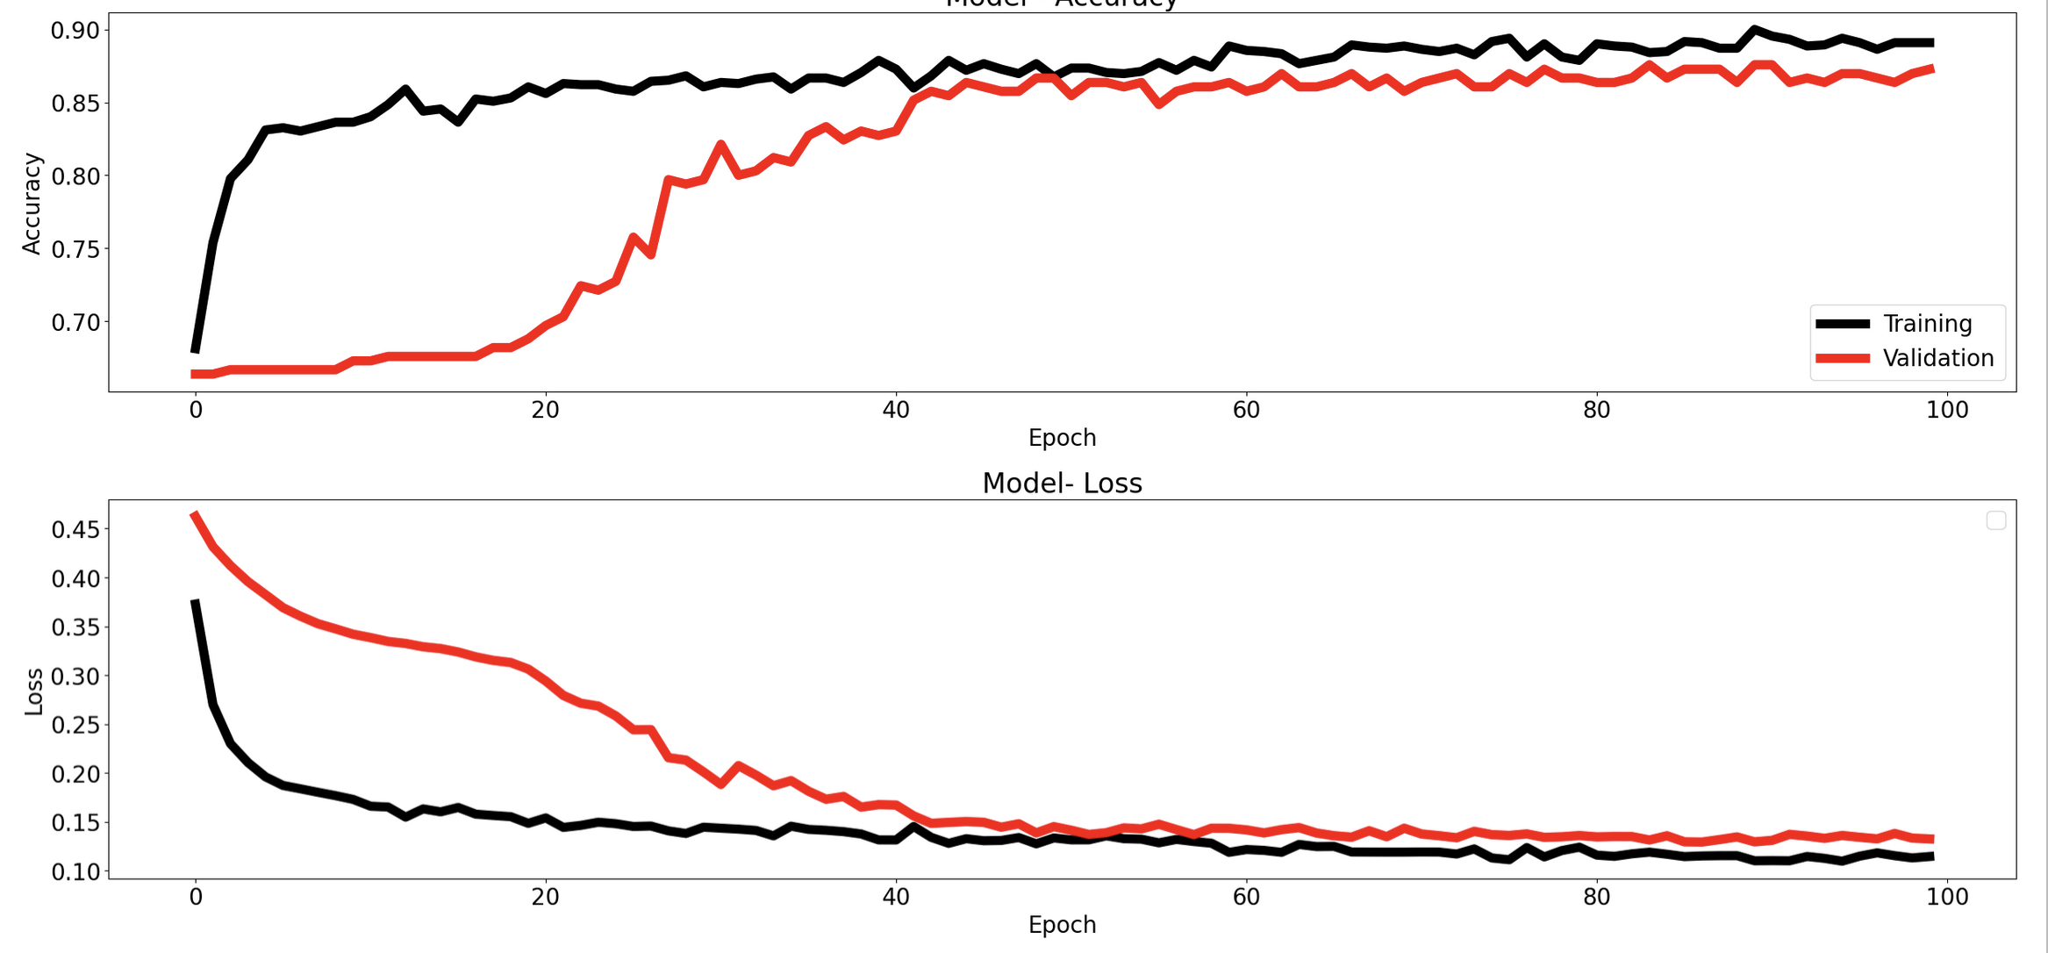
Notes:
Accuracy curves show the rate at which the model is being trained and the accuracy of that model using validation data. Loss shows how far off the model’s predicted ouput was from the true output, so as it gets better, the loss is minimal

Slide 12
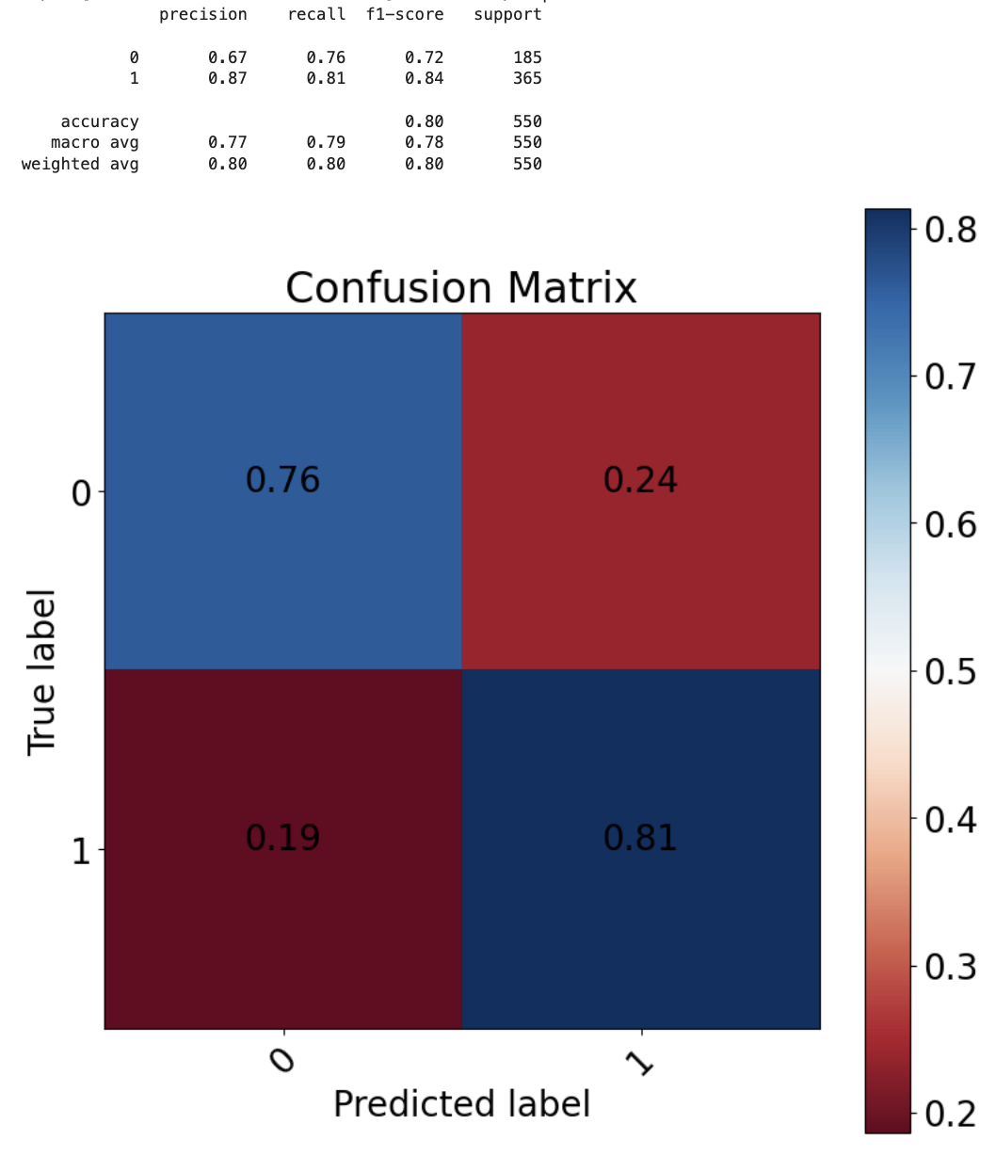
NN - Planetary
Overall Accuracy score of 80%
Not that great (comparatively)
Models require layers with density, normalization, and more
To train they require optimizers, loss functions, etc
Likely some user error causing subpar performance
Notes:
The NN did not perform as great as the other model, but accuracy of 80% is still decent. These models are much more complex to make with different types of layers, optimizers, loss measuring functions, etc so with more time and more skilled user input the model would likely improve and outperform the machine learning model. Based on accuracy and loss curves, some overfitting could have occured

Slide 13
Summary
Classification of objects of interest using different size datasets & models
Simple machine learning models were good on the fly – deep learning likely will outperform if used correctly
Future work could include one-class classification, including analysis of probabilities to determine which objects are worth pursuing first
Notes:
The goal was to create a classification algorithm which took objects from KOI database. Different models and datasets were tested
It seems like the machine learning models are a great initial guess and can provide decent accuracy, but deep learning will likely do better with a more skilled modeler.
In the future, this could be expanded to use one-class classification, which is somewhat like anomaly detection. Given the initial proportion this could be feasible. Also analyzing the probability distributions given when classifying the candidate group could tell us which ones the model has higher confidence in, and this could tell us which objects to prioritize if they’re closer to being confirmed

Slide 14
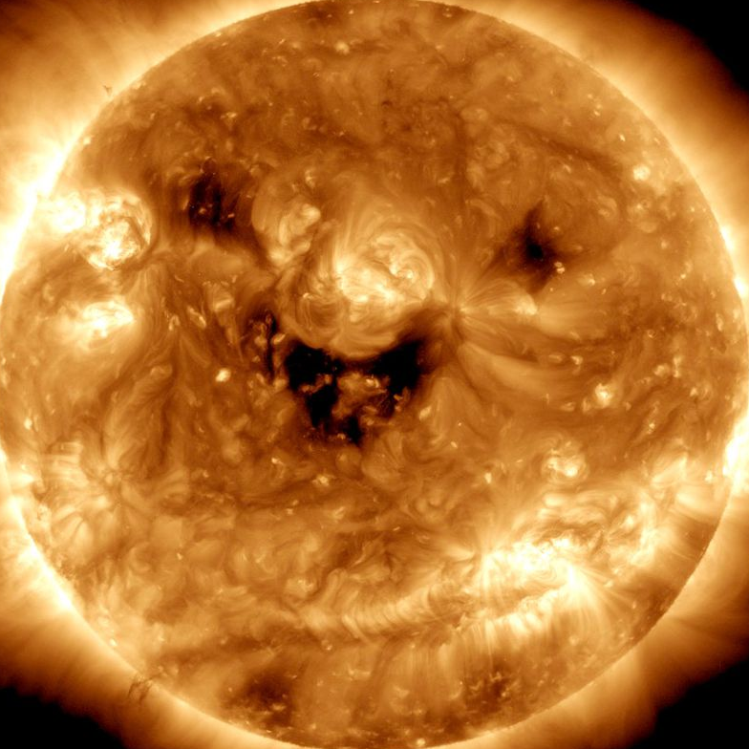
Thank You!
Questions?

